Slide 1


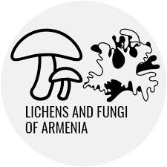

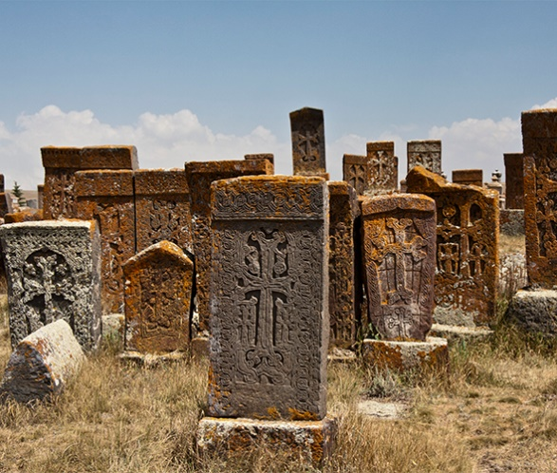
Modelling lichen colonization on an Armenian cross-stone (khachkar)
Senior Laboratory Assistant at the A. Takhtajyan Institute of Botany
Member of the International Association for Lichenology
Reseacher at the Lichens Research and Conservation Group
PhD Studend
Naira Sargsyan
Senior Laboratory Assistant at the A. Takhtajyan Institute of Botany
Researcher at the Lichens Research and Conservation Group
Acopian Center for the Environment, AUA
Mariam Gevorgyan
11-16.05․2026
Dilijan
gevorgyanmar2@gmail.com
sargsyannara259@gmail.com

Slide 2
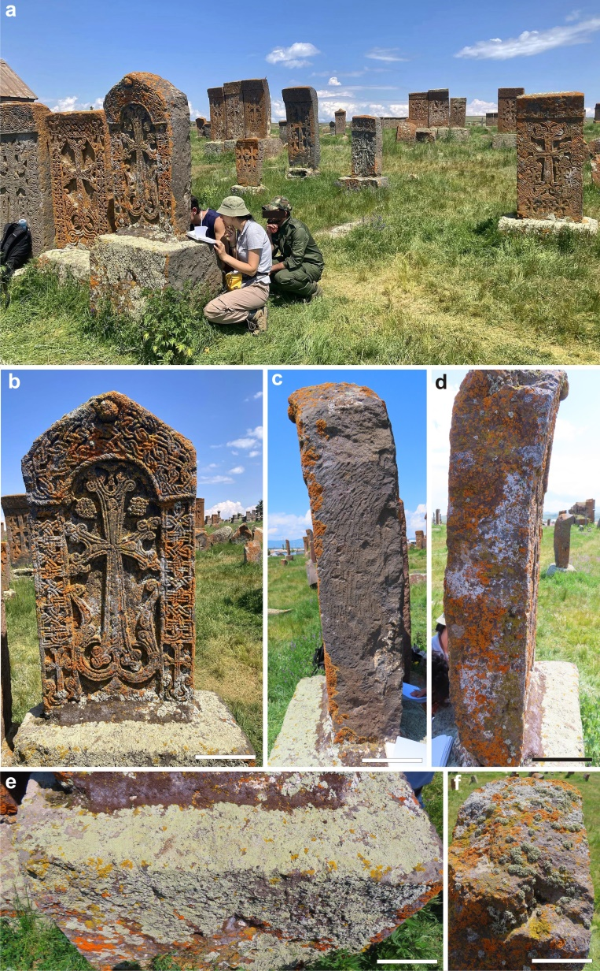
Study Area
Research conducted at Noratus, near Lake Sevan
One of the largest medieval khachkar cemeteries in Armenia
Contains nearly 1,000 khachkars dating from the 9th–17th centuries
Diverse climate and microhabitats support rich lichen diversity
The studied khachkar was made of basalt and dated to the 13th-14th centuries
Fig.1. Study site and sampling design on the khachkar

Slide 3

Aim and Significance of the Study
Aim
To investigate lichen colonisation patterns on medieval khachkars at Noratus
To identify the ecological factors controlling lichen distribution
To evaluate the potential impact of lichens on basalt deterioration and monument conservation
Significance
Provides the first detailed ecological study of lichens on Noratus khachkars
Improves understanding of microhabitat-driven lichen communities on cultural heritage stone
Helps assess the balance between biodeterioration and protective roles of lichens
Supports sustainable and non-invasive conservation strategies for Armenian cultural heritage

Slide 4
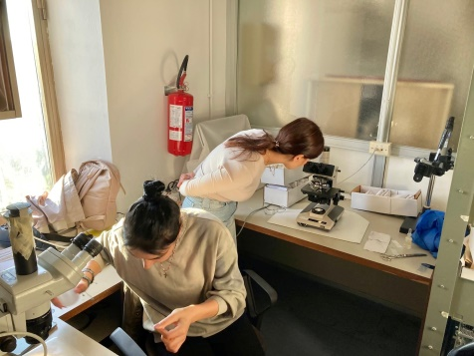
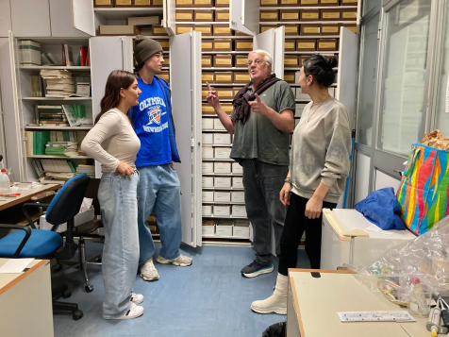
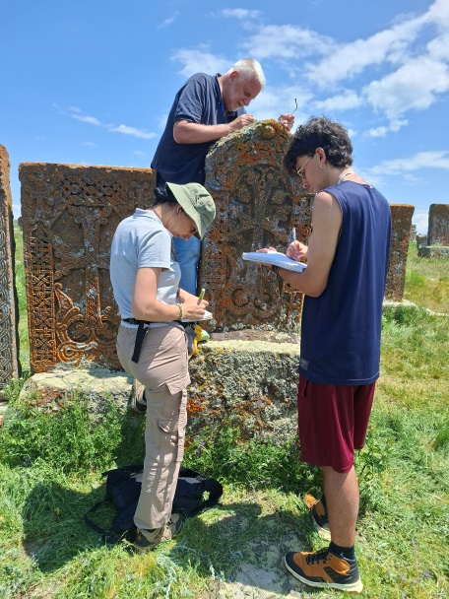
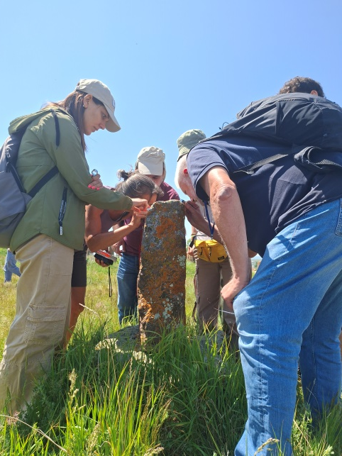
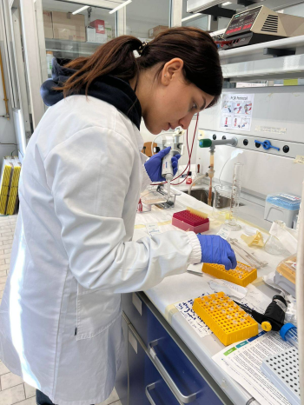
Modelling lichen colonization on an Armenian cross-stone (khachkar)
Work commencement in Noratus, Armenia:
June 2025
Work progress in Trieste, Italy:
November 2025

Slide 5
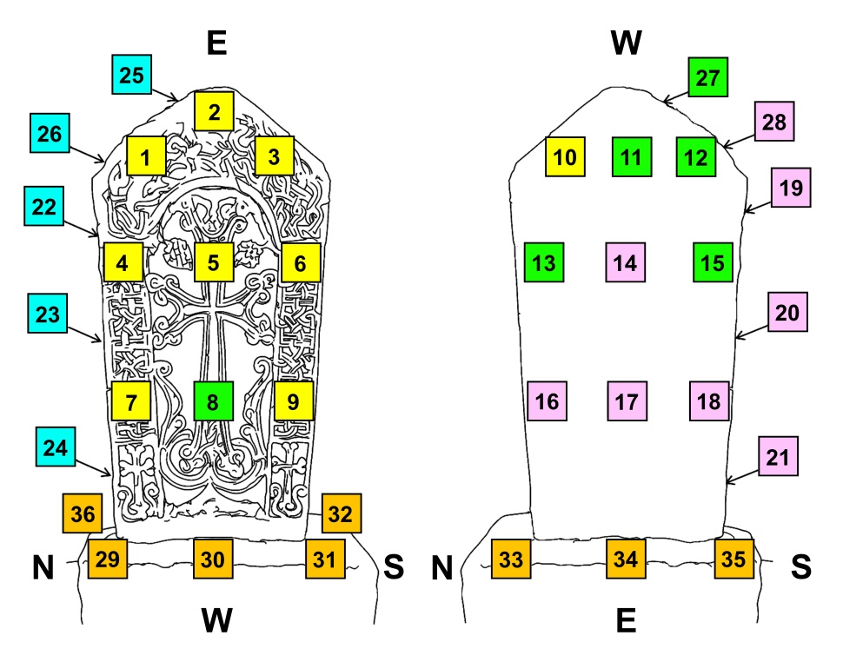
Materials and Methods
Field methods
Visual field survey
Relevé sampling (Braun-Blanquet method)
Braun-Blanquet cover scale
Microhabitat analysis
Macroscopic field identification
Reference / identification method
Comparative reference method
Ecological analysis
Ecological indicator analysis (Nimis method)
Statistical analysis
Hierarchical cluster analysis (Ward’s method)
Ordination analysis (PCA)
Multivariate statistical analysis (R software)
Fig.2. Spatial distribution of lichen sampling plots on the monument

Slide 6
Results
Preliminary survey of 30 khachkars in Noratus showed mostly homogeneous lichen communities
One atypical stone (different siliceous rock) had a distinct species set
The selected khachkar was representative of the cemetery
In total, 27 lichen species were recorded (mostly crustose epilithic forms)
Ecological pattern showed a shift toward slightly dry and strongly eutrophic conditions
Main vegetation groups identified:
Group A: Orange-dominated lichens on west-facing vertical surfaces
Group B: Similar to A, but on upper east-facing areas
Group C: North-facing zones; fruticose and foliose species, greenish/whitish appearance
Group D: Low lichen cover, mainly south-facing surfaces
Group E: Horizontal basement surfaces, high cover, pale yellow-green
Overall, three main lichen communities were identified based on habitat preference and exposure:
  North-facing community
  Horizontal surface community
  General vertical surface community

Slide 7
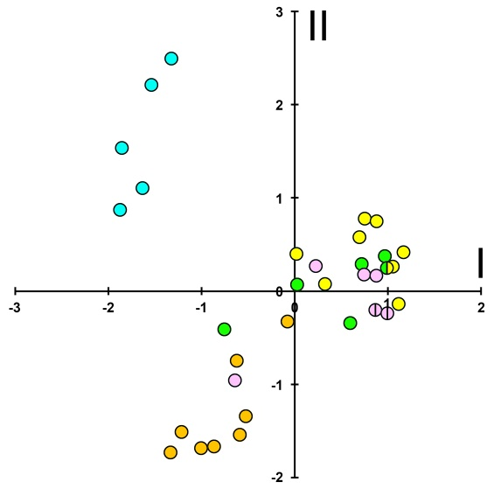
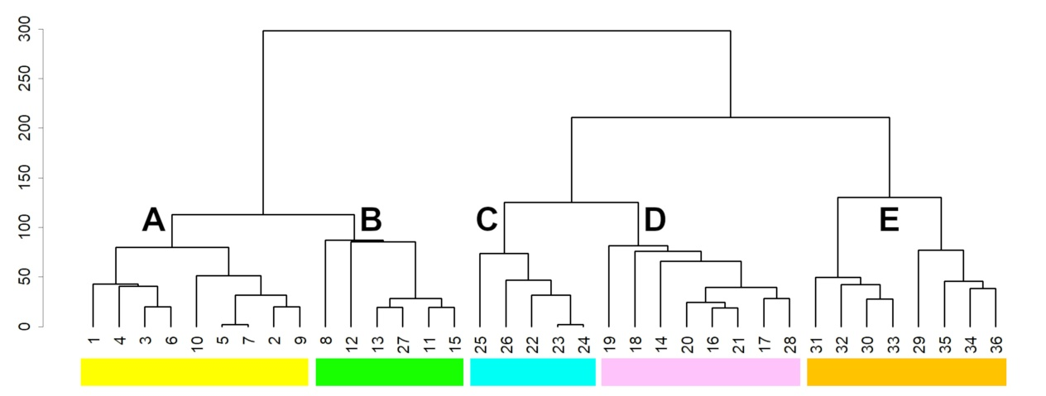
Fig.3. Ecological preferences of lichen biota: aridity and eutrophication gradients
Fig.5. Ordination analysis of lichen relevés and ecological group differentiation
Fig. 4. Hierarchical clustering of lichen relevés (community grouping)

Slide 8
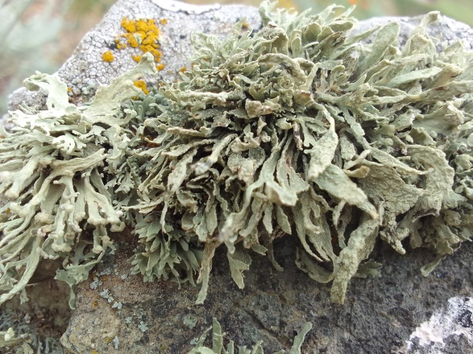
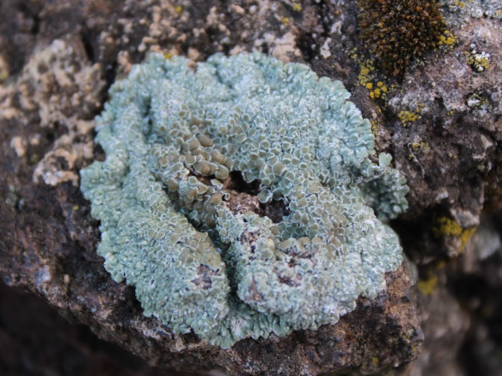
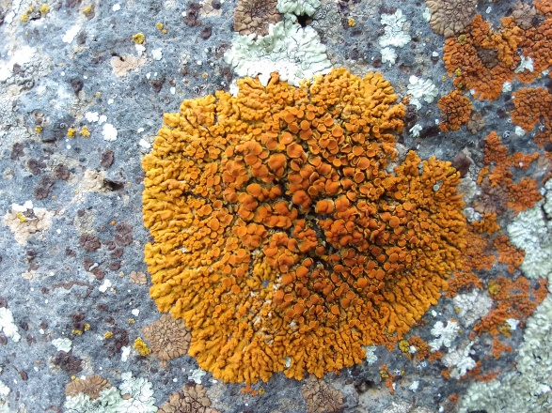
Ecological Drivers of Lichen Distribution
Lichen species show broad (holarctic/subcosmopolitan) distributions
Colonisation is controlled mainly by environmental filters, not endemic flora
Key drivers: solar radiation, aridity, nutrient enrichment (eutrophication)
Nutrients likely come from dust, agriculture and bird activity
Microhabitat moisture is the main structuring factor
North-facing surfaces → humid, moisture-demanding communities
South/sun-exposed surfaces → dry, stress-tolerant species
Monument shows strong microhabitat heterogeneity
Three main community types:
  North-facing: humidity-dependent, fruticose/foliose lichens Ramalina polymorpha community (Group C)
  Horizontal surfaces: nitrophilous Protoparmeliopsis muralis community (Group E)
  Vertical sun-exposed: Rusavskia elegans dominated community (Group A, B, D)

Slide 9
Conclusions
Lichen colonisation at Noratus is mainly controlled by
microhabitat moisture,
exposure
nutrient input
These factors create a clear and predictable spatial pattern of lichen communities
Lichens may contribute to mineral mobilisation in basalt, but
→ structural impact is currently limited under dry–cold conditions
The main visible effect is chromatic alteration (colour changes)
→ which has become part of the cemetery’s visual character
Conservation should be proportionate and non-invasive
  focus on monitoring
  intervene only where real material risk exists
  consider aesthetic and cultural value of lichens

Slide 10
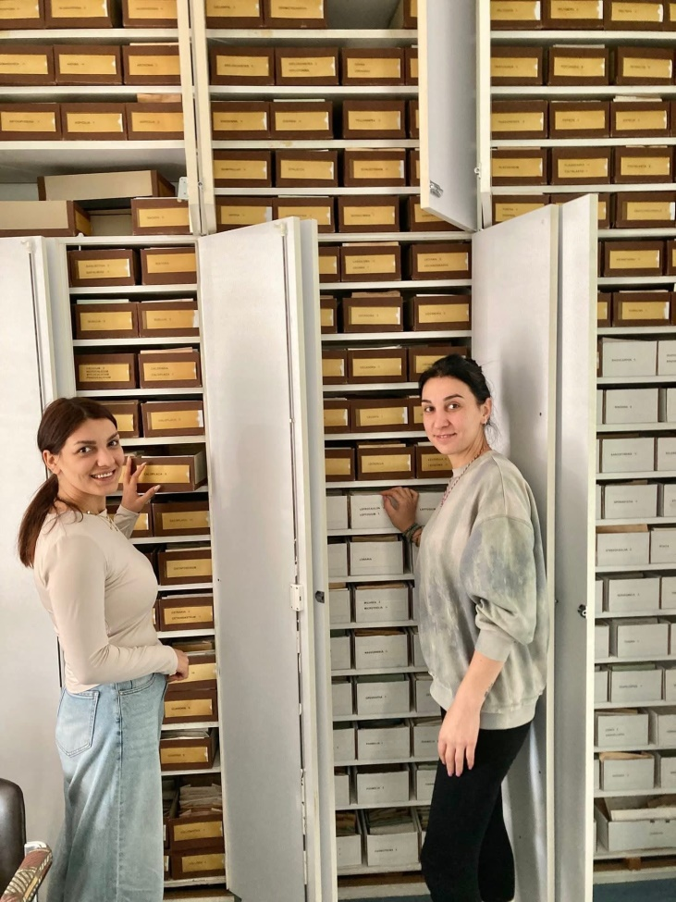
Thank you for your attention!

